Slide 1
Creating a Sense of Belonging in Your Classroom: A Practical Teacher’s Guide
2025-05-13 Hsiang-Chen Yeh

Slide 2
CONTENTS
💡 Why Student Belonging Is Important
🧩 Evidence-Based Activities to Foster Belonging
🗣️ Action Sentence Starters for Daily Classroom Use
🎞 Video Library

Slide 3
01
💡 Why Student Belonging Is Important

Slide 4
💡
Why Student Belonging Is Important
Belonging is a core psychological need. When students feel accepted, valued, and understood, they:
Show improved academic
Have better mental and physical health
Build stronger motivation and relationships
Are more likely to persist through challenges

Slide 5
02
🧩 Evidence-Based Activities to Foster Belonging

Slide 6
🧩 Evidence-Based Activities to Foster Belonging
Strategy | What You Can Do | Why It Works
1.Build Personal Connection (Goodenow,1993) | •Greet students by name •Check in when they seem off •Chat briefly about interests | Students feel seen and respected
2.Normalize Struggles (Walton&Cohen,2011; Walton&Brady,2020) | •Share stories of past students’ challenges •Have students write letters to future students | Helps students reframe early struggles as normal
3.Use “Wise Feedback” (Cohenetal.,2006) | •Pair high expectations with support •Use reflection assignments on personal values | Builds confidence and combats stereotype threat
4.Cooperative Learning (Johnson & Johnson,2009) | •Use Jigsaw or team projects •Assign individual roles in groupwork | Promotes peer connection and shared success
5.Share & Celebrate Culture (Banks,2004) | •Invite students to share traditions •Integrate diverse voices in lessons | Increases inclusion for students from all backgrounds
6.Create a Safe Environment (Osterman,2000) | •Co-create class norms •Address bullying and exclusion | Makes students feel emotionally and physically safe

Slide 7
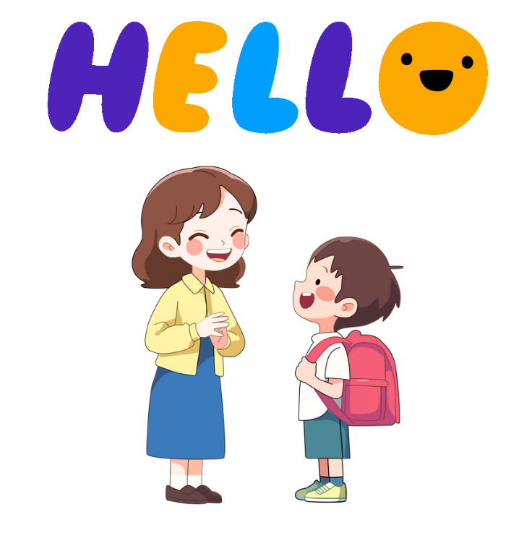
1.Build Personal Connection
•Greet students by name
•Check in when they seem off
•Chat briefly about interests
Students feel seen and respected
(Goodenow, 1993)​

Slide 8
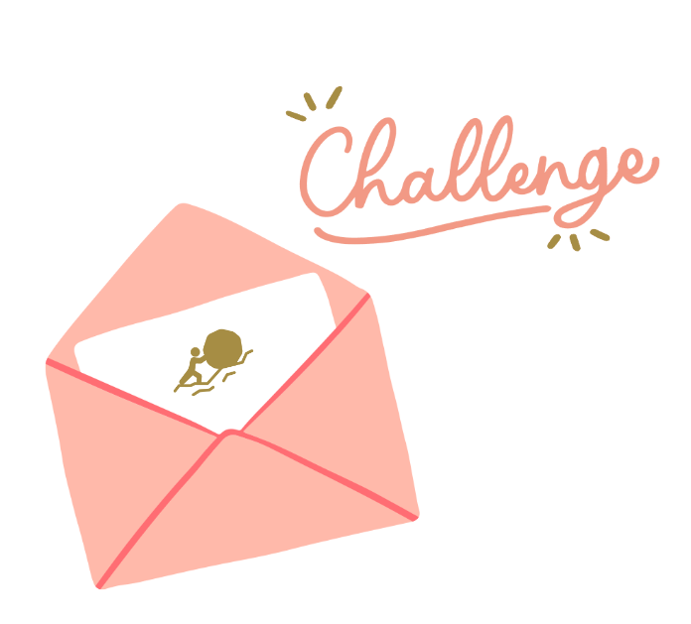
2.Normalize Struggles
•Share stories of past students’ challenges
•Have students write letters to future students
Helps students reframe early struggles as normal
(Walton & Cohen, 2011; Walton & Brady, 2020)

Slide 9
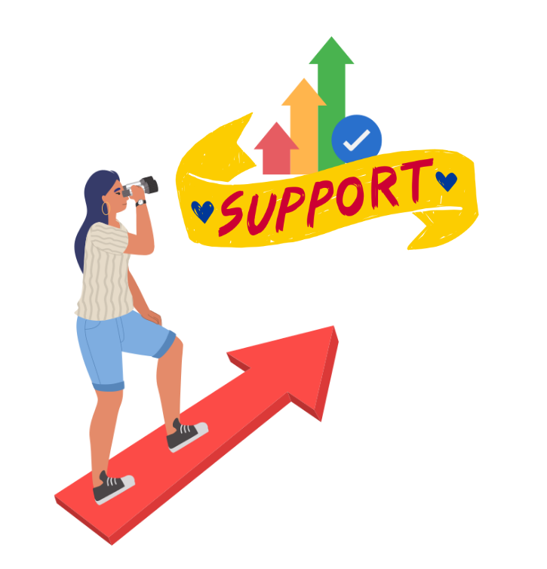
3.Use “Wise Feedback”
What Is “Wise Feedback”?
Wise feedback is a powerful teaching strategy that pairs high expectations with explicit reassurance and support. It tells students:
“I’m giving you this feedback because I know you’re capable of succeeding.”
This type of feedback is especially effective for students who may feel unsure if they belong—such as those affected by stereotype threat or self-doubt. When teachers express belief in a student’s potential and provide the support to reach it, it helps students:
Feel seen and respected
Stay motivated
Develop resilience and confidence
Why it matters:
Research (Cohen et al., 2006) shows that wise feedback improves performance, strengthens trust between teachers and students, and combats stereotype threat by affirming students’ value and ability.
•Pair high expectations with support
•Use reflection assignments on personal values
Builds confidence and combats stereotype threat
(Cohen et al.,2006)

Slide 10
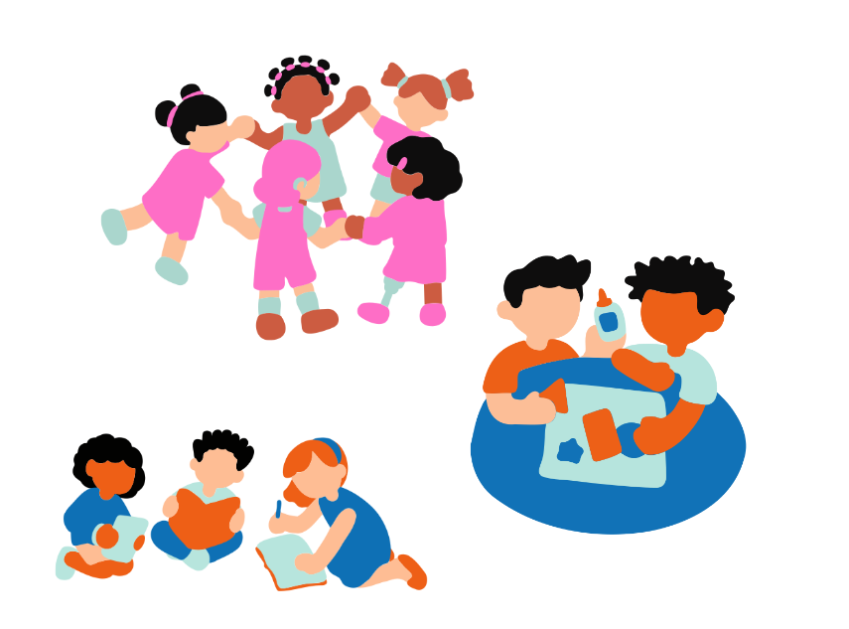
What Is the Jigsaw Method?
The Jigsaw method is a powerful cooperative learning strategy where each student becomes an expert on one part of a topic, and then teaches that part to their peers.
How It Works:
Divide a topic into several subtopics.
Assign each student (or group) one subtopic to learn deeply—this is their “expert group.”
Students meet in their expert groups to discuss and master their subtopic.
Students then return to their original “jigsaw group,” where each student teaches their part to the rest of the group.
Why It’s Effective:
Every student plays a valuable role, which builds a sense of contribution.
Encourages active listening, teamwork, and peer teaching.
Helps students feel responsible and respected for their knowledge.
Increases understanding by teaching others, not just listening.
It’s called “Jigsaw” because each student’s piece is essential—just like a puzzle.
4.Cooperative Learning
•Use Jigsaw or team projects
•Assign individual roles in groupwork
Promotes peer connection and shared success
(Johnson & Johnson, 2009)

Slide 11

5.Share & Celebrate Culture
•Invite students to share traditions
•Integrate diverse voices in lessons
Increases inclusion for students from all backgrounds
(Banks, 2004)

Slide 12
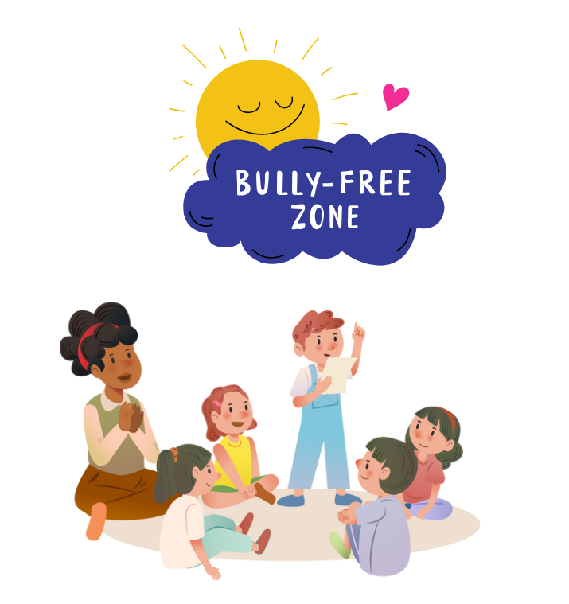
Address Bullying and Exclusion
What it means:
Actively recognizing and responding to unkind behavior, social isolation, or hurtful comments in the classroom—whether it’s physical, verbal, social, or online. It means creating a culture where everyone belongs and no student feels invisible or unsafe.
What It Looks Like in the Classroom:
Stopping it early: When a student rolls their eyes, whispers behind another’s back, or leaves someone out, gently step in and address it. How can people address it. Address bullying immediately: What does it look like
Speaking up: Say things like “We don’t leave people out in this class” or “Everyone deserves respect here.”
Restorative conversations: Guide students in talking through conflicts, apologizing, and understanding each other’s feelings. Expand: What can those conversations look like
Regular check-ins: Watch for quieter students who may be excluded or withdrawn and ask how they're doing.
Inclusive activities: Use group games or seating plans that mix students up so no one is always left out.
Why it matters:
When teachers take small moments seriously, it signals to students that this classroom is a safe and caring space. Addressing exclusion early builds trust and prevents deeper harm.
6.Create a Safe Environment
•Co-create class norms
•Address bullying and exclusion
Makes students feel emotionally and physically safe
(Osterman, 2000)

Slide 13
03
🗣️ Sentence Starters for Daily Classroom Use

Slide 14
🗣️
Sentence Starters for Daily Classroom Use
Context | Suggested Language
A student seems withdrawn | “I noticed you were quiet today—want to talk about it?”
Giving feedback | “I’m giving you this feedback because I know you can grow even more.”
After group work | “Thanks for being such a great teammate—your role really mattered.”
Addressing the class | “In our classroom, everyone’s voice and story matter.”
Discussing struggle | “Most students feel unsure at first. It doesn’t mean you don’t belong.”
Welcoming cultural sharing | “That tradition is so meaningful—thanks for sharing it with us.”

Slide 15
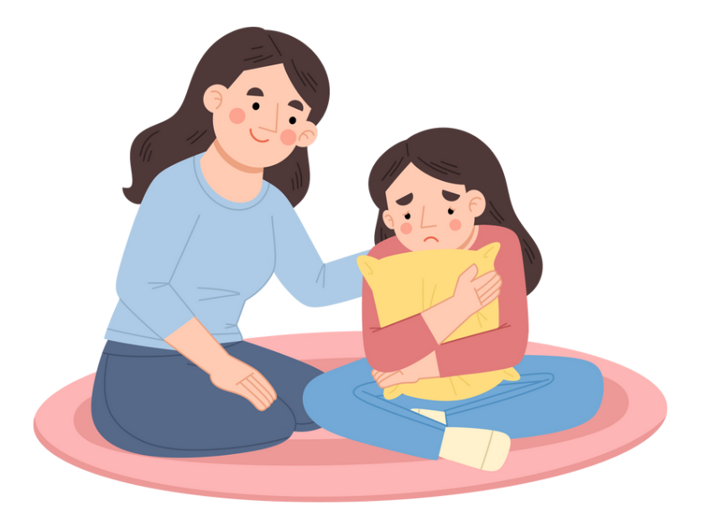
1. A student seems withdrawn
“I noticed you were quiet today—want to talk about it?”

Slide 16
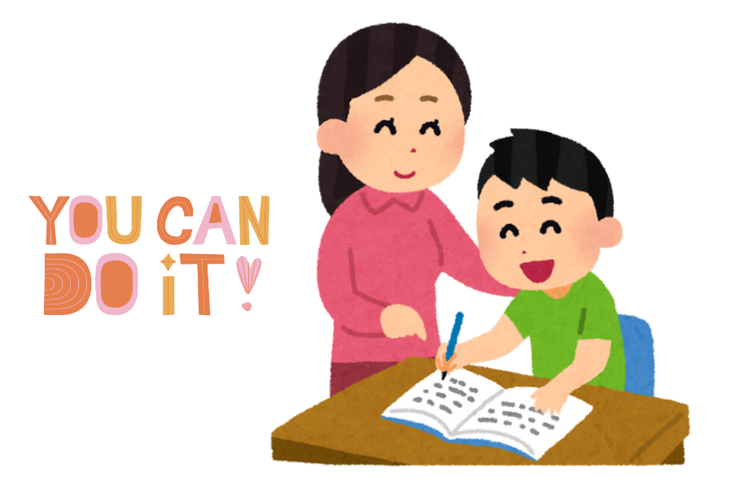
2. Giving feedback
“I’m giving you this feedback because I know you can grow even more.”
More Feedback Strategies That Show You Believe in Students: Six slides
1. Name the Strength First
“You explained your idea really clearly here — let’s see how we can add more details to make it even stronger.”
Starts with encouragement and builds momentum for improvement.
2. Be Specific, Not Generic
Instead of “Good job,” say:
“I like how you supported your opinion with an example from the story.”
Helps students know exactly what to keep doing and builds confidence.
3. Focus on Effort and Process
“I can tell you worked hard to organize your thoughts — let’s keep building on that.”
Reinforces a growth mindset and values persistence.
4. Invite Student Reflection
“How did you feel about this part? Where do you think you improved?”
Encourages ownership and deeper engagement with learning.
5. Connect to Progress Over Time
“Last month this was tough for you, but now look at how much clearer your writing is!”
Makes growth visible and motivates continued effort.
6. Use Encouraging Language for Mistakes
“Mistakes are part of learning — I’m glad you took a risk here. Let’s see how we can revise it.”
Normalizes struggle and reduces fear of failure.

Slide 17

3. After group work
“Thanks for being such a great teammate—your role really mattered.”

Slide 18
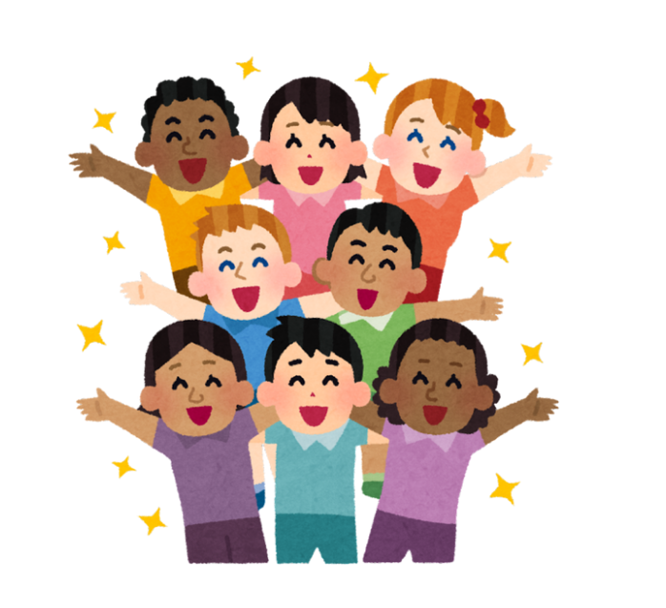
4. Addressing the class
“In our classroom, everyone’s voice and story matter.”

Slide 19
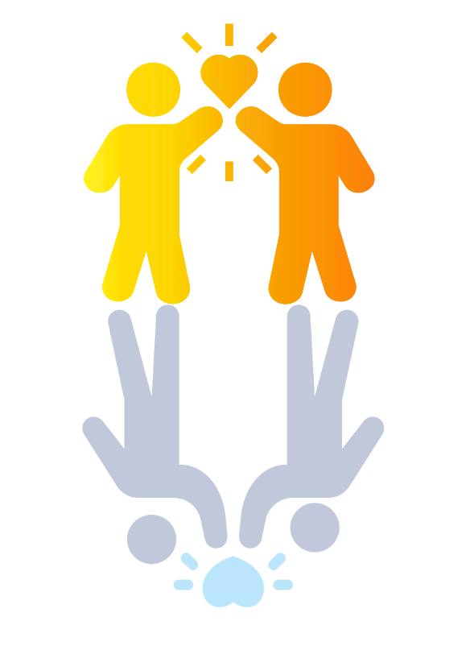
5. Normalizing Struggles in Peer Settings
“Most students feel unsure at first. It doesn’t mean you don’t belong.”

Slide 20
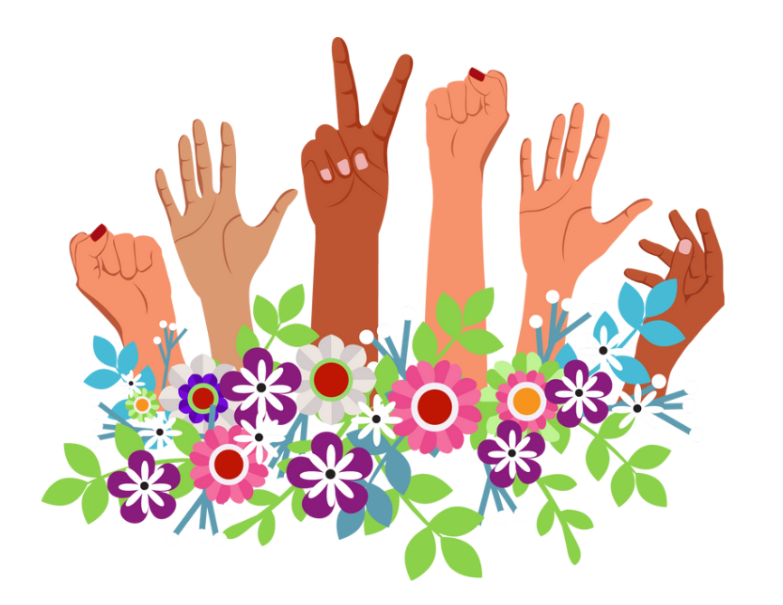
6. Welcoming cultural sharing
“That tradition is so meaningful—thanks for sharing it with us.”

Slide 21
04
🎞 Video Library
Family’s Videos | Teachers’ Videos | Teens’ Videos | Children’s Videos

Slide 22
Family’s Videos
For parents—to understand and support your child.
1.Promoting Child and Teen Mental Well-being
How families can support a child's mental health
A parent's perspective on children's mental illness
The Importance of Raising an Emotionally Intelligent Child
Raising Happy Teenagers
2. Resilience Building for Families
The seesaw effect: building children’s resilience by emotional regulation
3. Exploring Teen Career Paths
Questions Every Teenager Needs to Be Asked
4. Supporting Children and Teens with Depression
10 Ways to Help When Your Child is Depressed
Tackling Teenage Depression
How To Help Your Teen With Depression
5. Parenting a Suicidal Child or Teen
How Do I Parent My Suicidal Child/Teen?
6. Supporting Children with Anxiety
Children's Anxiety: 3 Ways to Help Your Anxious Child
How to raise kids who can overcome anxiety
7. Understanding and Connecting with Teens
What Teenagers Want You to Know
Be a better parent by partnering with your teen
How To Make A Shy Kid Confident
8. Helping Anxious Children: A 4-Part Parenting Guide
How to Help a Child With Anxiety: A Parent-Centered Approach to Managing Children’s Anxiety Part 1
How to Create Emotional Safety for a Child with Anxiety Part 2
Teach your kid to face their fears with scaffolding - Help anxious children part 3
12 Ways to Help A Child with Anxiety Part 4
10 Tips for Parenting Anxious Kids | Child Mind Institute

Slide 23
Teachers’ Videos
For teachers—to support student mental health and learning.
1. Building Resilience in the Classroom
How to build resilient children
2. Supporting Students with Anxiety and Depression
Classroom Strategies to Support Student Depression & Anxiety
Ask the experts: Depression in kids and how to help
Grounding Exercise to Manage Anxiety
3. Understanding and Supporting Students with ADHD
Strategies to Support Students with ADHD
Rethinking ADHD
4. Engaging Teaching and Learning Strategies
How to make students (and teachers) want to go to school
5. Emotion Regulation and Student Mental Health
Why Teaching Teens Songwriting Can Make the World a Better Place
Rethinking Challenging Kids-Where There's a Skill There's a Way
Teacher’s ‘emotion check-in’ helps students share their feelings (kids)
Check-In / Check-Out: Providing a Daily Support System for Students (kids)
Managing Intense Emotions for Middle School Students
Mindfulness for Middle School Students
6. Guiding Teens on Career Exploration
Questions Every Teenager Needs to Be Asked
How to Find Your Path After School
7. Creating Trust and Belonging in School Settings
Every kid needs a champion

Slide 24
Teens’ Videos
For teens—to explore future paths, build friendships, and get to know yourself.
1. Exploring Future Careers: A Teen’s Guide
Questions Every Teenager Needs to Be Asked
How to Find Your Passion and Make it Your Job
2. Understanding and Coping with Anxiety
Exploring Anxiety and Stress Management (Teens)
Stress Management Tips for Kids and Teens!
Teen stress from a teen perspective
How We Cope With Anxiety & Stress
Conquering exam stress: lessons from our bodies
What Your Grades Really Mean
Relaxation Skills for High School Students: How to Cope with Stress & Anxiety
Mindfulness - Middle School
Mindfulness for High School Students
3. Managing Emotions and Mental Health
Understanding Feelings for Middle School Students : Tips for Self-Awareness & Emotional Control
Understanding Thoughts for Middle School Students
4. Making Friends: Tips for Teens
Boundaries and consent for teens
5. Cell Phone and Social Media Addiction
Cell Phone Addiction
Impact of Social Media on Youth

Slide 25
Children’s Videos
For children—to understand feelings, make friends, and build confidence.
1. Understanding and Coping with Anxiety
Grounding Techniques For Kids - Grounding Exercises For Anxiety And Other Big Emotions
Fight Flight Freeze Response-Anxiety & Stress-The Downside Of The Survival Brain-How To Calm It Down
5 Tips for Coping with Test Anxiety (for kids!)
Real kids talk about coping with anxiety
Belly Breathing: Mindfulness for Children
Butterfly Hug!
2. Understanding Childhood Depression
Depression For Kids - Coping Skills For Low & Depressed Mood
3. Managing Emotions and Mental Health
Anger Management for Kids: How to stay calm when you feel like blowing up!
Anger Management for Kids!
Accepting NO Social Story Emotional regulation social stories
The Feelings Song
It’s OK to Feel All Kinds of Feelings
Coping with Grief (for kids)
What Mental Health Is and Why It’s Important to Take Care of It?
Stress Management Tips for Kids and Teens!
Setting Boundaries with Friends
Managing Intense Emotions - Elementary School | Child Mind Institute
4. Making Friends: Tips for Kids
How To Help Your Child Make Friends
How To Teach This Is The Way We Make Friends - Social Skills Song for Kids!
Friendship Skills for Kids: Making and Keeping Friends
How To Be A Friend?
Social Emotional Learning For Kids: Benji, the Bad Day, and Me
All About Empathy (for kids!)
5. Building Social Skills for Children
I Can Get Attention Social Skills Story
Improve social skills | Kids story Social confidence | Manageable steps explained
All About Social Skill for Kids!

Slide 26
Teaching students how to manage hard feelings
what does it look like when students are experiencing anxiety
Anger, Frustration, Sadness,
Videos, sentence starters, strategies
Box breathing
Deal with anxiety, depression (what does it look like, conversation starter, how to support)
promoting hope
Creating Belonging, Emotional Regulation, Managing Anxiety, Managing Depression

Slide 27
THE END
THANKS

